Slide 1
Cloud transformation
Microservices, docker and container
John Kesinger

Slide 2
Live!360 Orlando
Azure Cloud Transformation Done Right - Marcel de Vries
https://live360events.com/Events/Orlando-2019/Sessions/Thursday/CCH06-Azure-Cloud-Transformation-Done-Right.aspx
Workshop: Building, Running & Continuously Deploying Microservices with Docker Containers on Azure - Marcel de Vries & Rene van Osnabrugge
https://live360events.com/Events/Orlando-2019/Sessions/Monday/CCM01-Workshop-Building-Running-Continuously-Deploying-Microservices.aspx
How Microsoft Does Devops – Mickey Gousset
https://live360events.com/Events/Orlando-2019/Sessions/Tuesday/VST03-How-Microsoft-Does-DevOps.aspx

Slide 3





Notes:
Who has heard about the 5 monkeys’ experiment? Well, if you have, this story is a slightly modified version of it. If you haven’t, the story goes a little something like this.
There were 5 monkeys. They were tasked with creating a platform to reach hanging bananas in a tree. They all worked together, built the platform, and got the bananas. The end.
Simple. Right?
Well… no. You see, the monkeys got tired of eating bananas. They wanted to try the pineapples on the other side of the jungle. So, they all worked together, moved the platform to that side of the jungle, and reached the pineapples.
Simple. Right?
Well… no. You see, the platform wasn’t built for that side of the jungle and after the move, the platform became brittle and boards needed to be replaced.

Slide 4
Notes:
They all began to work together, but then one monkey spoke up and said, “You know… some of these boards aren’t treated and bugs have eaten into them and that’s what caused the brittleness. Before we cut them, pass the boards to me and I’ll approve or deny them.”
Simple. Right?

Slide 5
Notes:
Well… no. Another monkey spoke up, “You know… we aren’t using the right types of boards. These boards aren’t high performant and can’t handle the stress of moving. Before we use them, pass the boards to me and I’ll approve or deny them.”
Simple. Right?

Slide 6
Notes:
Well… no. Yet another monkey spoke up, “You know… the real reason we have these problems is because we didn’t plan each section of the platform. Before we begin to think about cutting the boards, pass your plans to me and I’ll approve or deny them.”
Simple. Right?

Slide 7
Notes:
Well…no. Yet another monkey spoke up, “You know… the problem is we are too free to place the boards how each of us see fit. We need a process of placing these boards. Before we place them, pass the boards and your plans to me, and I’ll approve or deny them.”
Simple. Right?
Well… not exactly.

Slide 8
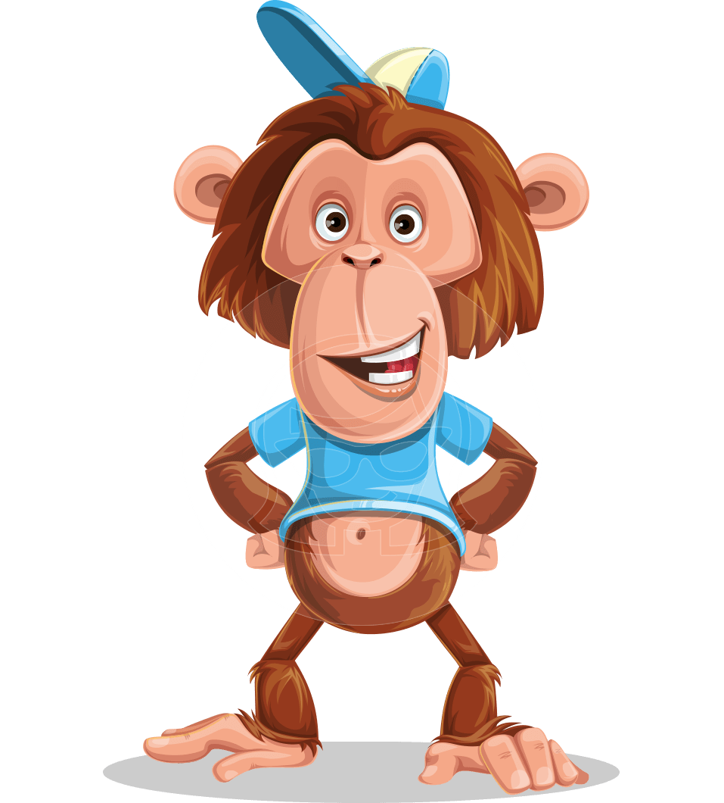
Notes:
Months had gone by and weather had really taken its toll on the platform. By this time, one of the monkeys had been replaced. The new monkey saw how the other monkeys were using wood and hand tools to build and maintain the platform.
He spoke up, “You know… we could use steel beams instead of w—". “We can’t risk it!” shouted the other monkeys. Taken back, he stayed silent after that.

Slide 9

Notes:
Weeks went by. Another monkey was replaced. This monkey saw how labor intensive it was to quality check each and every board before using it.
She spoke up, “You know… we could use a scanner to automate the s--”. “We can’t risk it!” shouted the other monkeys, including the last monkey that had just joined not too long ago. Taken back, she stayed silent after that.

Slide 10
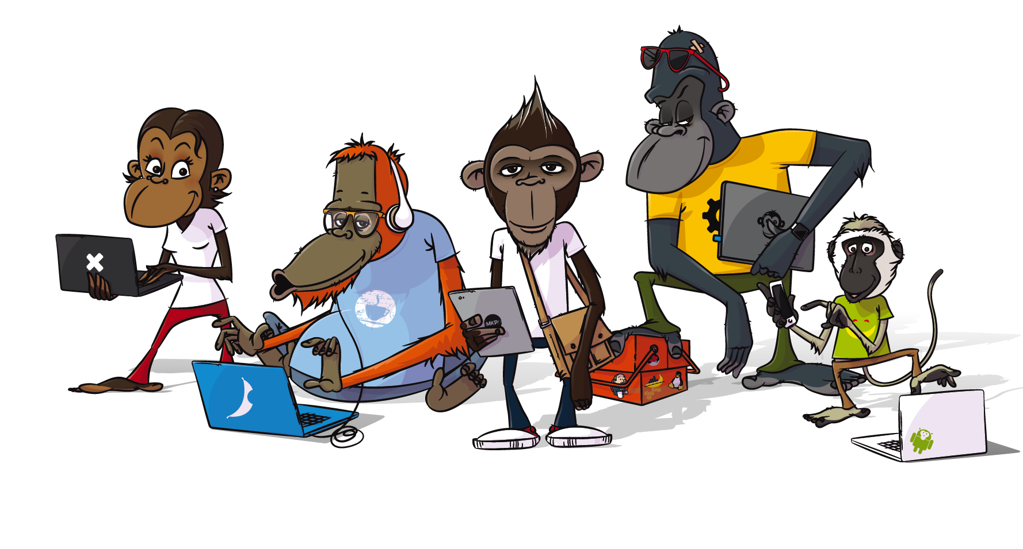
Notes:
Before you know it, all the original monkeys had been replaced.
They decided the next fruit they would attempt to get were the apples on the other side of the jungle. Every monkey worked diligently on the platform with the tools and processes they were given. They showed up, cut the boards, and followed the process. When they went to move the platform over to reach the apples, they realized the apples were much lower. In fact, they could have just used small ladder to reach them. Since they had spent so much time and energy building and maintaining the platform, they decided to continue using the platform and the process.
It is said to this day; the monkeys continue to build and maintain their platform using the original wood and original process. Each time a new monkey is cycled in, they are quickly acclimated to the way things are done. The monkeys work hard, incur little to no risk, and are extremely comfortable with the process they’ve built.
And they all lived happily ever after…

Slide 11
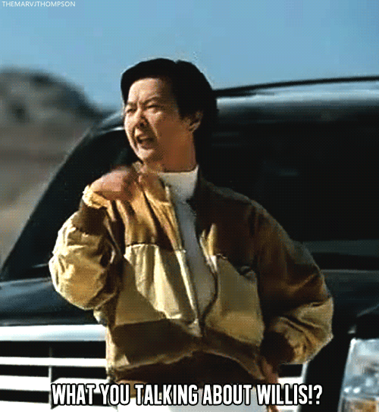
What does this have to do with cloud transformation?
DOCKER MICROSERVICES CLOUD CONTAINERS
BLOCKCHAIN KUBERNETES
A.I. DEVOPS
IoT M.L.
Notes:
What does this have to do with cloud transformation, docker, containers, or microservices?
To many, these are all just buzz words that influence CTOs to spend money with (insert your cloud provider name here). The fact is that technology in general is changing at exponential speed. In order to capitalize on that change, we have to change the way we think.

Slide 12
“The world as we have created it is a process of our thinking. It cannot be changed without changing our thinking.”
-Albert Einstein
Notes:
Also said like this.
“The world as we have created it is a process of our thinking. It cannot be changed without changing our thinking.” Albert Einstein.
As we saw in the story of the 5 monkeys, each used their perspectives to come up with a process on how to improve. That, inherently, is a good thing, however what happened is they never went back and re-examined the process as a whole to ask themselves, “Is this still working?” More importantly, is this still working in the world that we’re in today?
We have to change our thinking.

Slide 13

Why do we need to change our thinking?
Notes:
Why do we need to change?
“If it ain’t broke, don’t fix it”
“If you had seen how it used to be, you would see how much better off we are now”
“It’s just the Insperity way”
Those are some dangerous yet common phrases we hear and tell ourselves. That’s having a fixed mindset. That’s accepting the way things are because it’s too hard or too complicated to change them.
What I’m suggesting is that we have a growth mindset.
“How can we constantly improve?”
What policies do we need to change to make this happen?”
“That’s the Insperity way!”

Slide 14

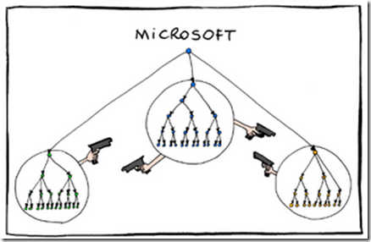
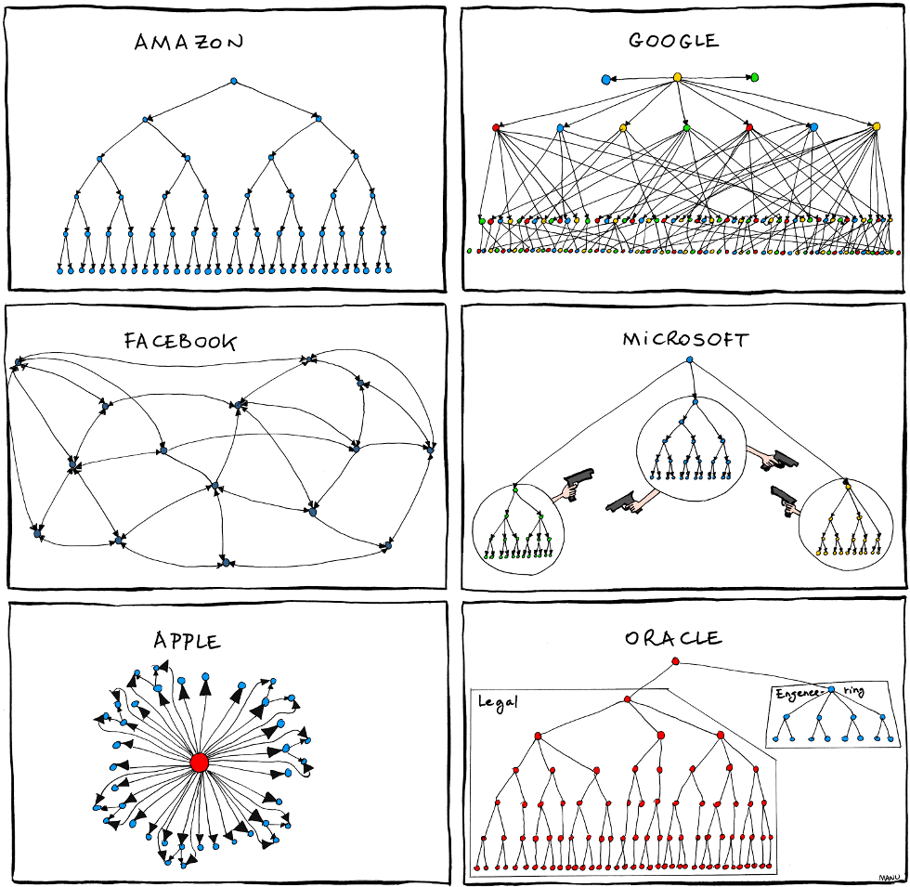

Slide 15
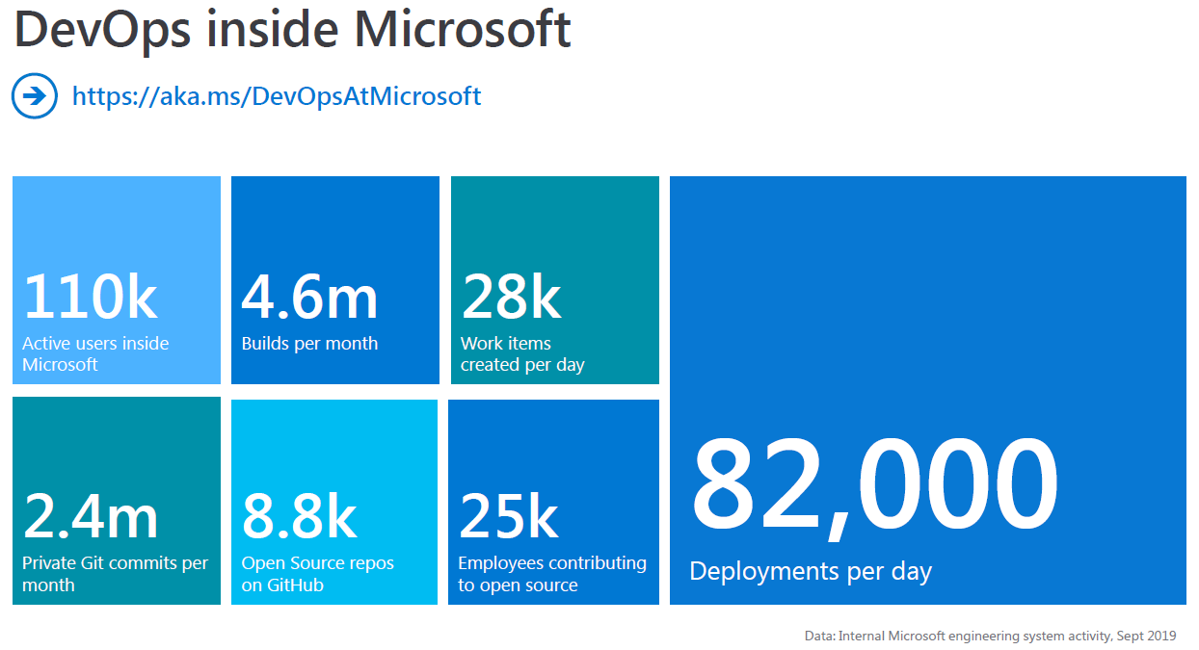
Technology advancement
“’Get thee to the cloud’ is obviously advice you’ve heard before, but it becomes imperative if you hope to capitalize on the exponential growth happening in cloud technologies.”
MSDN Magazine (Nov 2019)

Slide 16

Notes:
Where do we even start? Have you seen production?

Slide 17
3 Key Areas
Software Architecture
Software Delivery
Organization & Team Structure
Notes:
There are 3 key areas that require us to change our thinking and how we approach software development.
Software Architecture, software delivery and organizational/team structure.
These 3 areas may seem very independent of each other, however as you begin to change one of these areas, and as you begin to re-evaluate, you will notice the need to change the others.
For example, you can change your software architecture and reduce dependencies on other systems, but if you have a very manual process of delivering that software, it’s time to re-examine that process. If you change your team structure in a way that the team is autonomous and self-organizing, and you have everyone that’s needed to get the job done on the team- all aligned to the same goals, suddenly you start tripping over your monolith application because you can’t get changes out fast enough because of heavy regression testing etc. All of these changes need to happen in parallel or at least in a “semi-parallel” fashion.

Slide 18
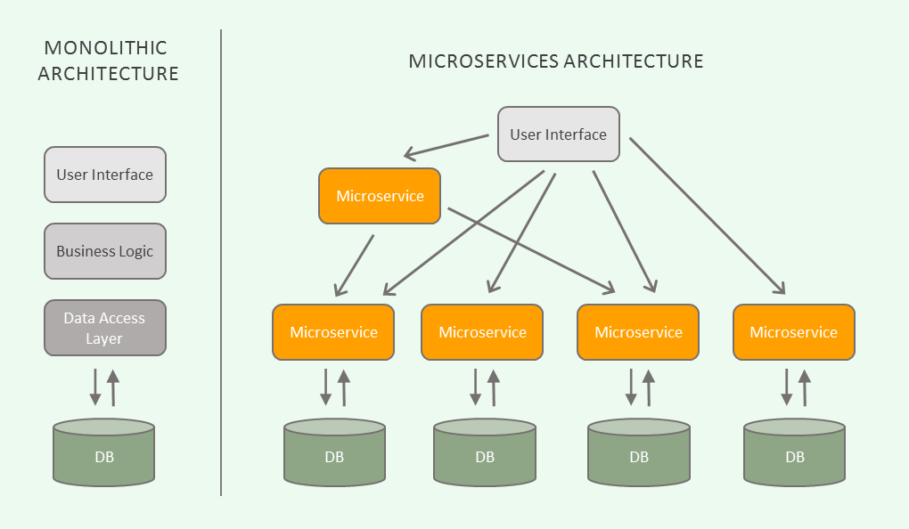
Software Architecture
“Monolithic applications can be successful, but increasingly people are feeling frustrations with them - especially as more applications are being deployed to the cloud . Change cycles are tied together - a change made to a small part of the application, requires the entire monolith to be rebuilt and deployed.”
https://martinfowler.com/articles/microservices.html
Notes:
Let’s start with software architecture.
“Monolithic applications can be successful, but increasingly people are feeling frustrations with them - especially as more applications are being deployed to the cloud . Change cycles are tied together - a change made to a small part of the application, requires the entire monolith to be rebuilt and deployed.” Martin Fowler.
Monolithic architecture traditionally looks like this. You have your UI, business logic, data access layer and your database. When your business logic layer (for instance) can’t handle the work load, what do you do? You throw a load balancer in front and create another instance of the entire application and now share the workload between the two instances.
With microservices, you separate functionality between different services within bounded contexts with as little coupling as possible which allows you to only scale the services that you need to. If microservice A isn’t keeping up, well, you scale another instance of it and move on.

Slide 19
Microservices
The microservice architecture enables the rapid, frequent and reliable delivery of large, complex applications. It also enables an organization to evolve its technology stack.
Little to no coupling between services
Functional cohesion vs Logical cohesion
Maintains its own state
Vertically sliced partitions
Organized around business capabilities
Notes:
An analogy that comes to my mind is McDonalds vs Subway. At McDonalds, they have one person taking order, another person making the fries, another person making the hamburgers, and another person collecting the money. Each person is a microservice in a sense. The “Fry-croservice”, “order taking microservice” and so on. At Subway, you have one person that gets the bread, meat, veggies, sides, collect the money, and give you the food. That would be an example of a monolith.
At McDonalds, the person making the fries essentially doesn’t care about the person making the burger. They just know to make a large order of fries. At Subway, the one person does each step in order and each step relies on the other to be completed first.

Slide 20
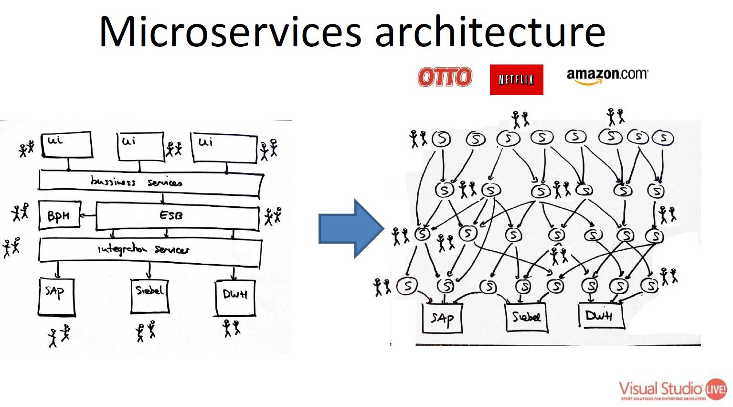
Moving to Microservices architecture
Benefits
Selective scaling
Resilience against failures
Deployment of smaller pieces – lower risk
High availability
Replicability
Composability
Notes:
The benefits are selective scaling, resilience against failures, lower risk, high availability, replicability, composability. On the left is your traditional monolith application, and on the right is the microservice architecture. With the added flexibility comes complexity. Yes you have the flexibility of scaling up and scaling down but now you have all of these different services to manage, maintain, and deploy. It’s apparent that your current release management processes won’t work efficiently with your changing architecture.

Slide 21
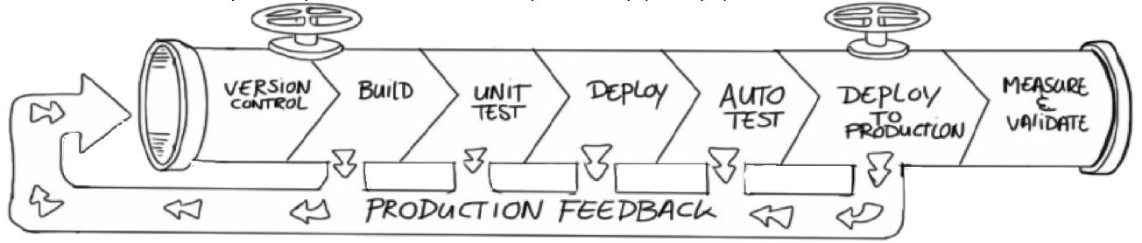
Software Delivery
“Research says that using the latest and greatest technology (like Kubernetes) has no correlation to a team or organization’s success. None. The ability to turn ideas into code and get code into production rapidly does.”
https://medium.com/@cfatechblog/edge-computing-at-chick-fil-a-7d67242675e2
Notes:
That’s when you start examining your software delivery processes.
“Research says that using the latest and greatest technology (like Kubernetes) has no correlation to a team or organization’s success. None. The ability to turn ideas into code and get code into production rapidly does.”
That quote is from Chic-fil-A’s tech blog on they implemented microservices across all of their restaurants to handle fluctuating demand and disconnected scenarios. Cloud-fil-A. With technology changing so fast, it is imperative that we can not only push ideas out, but also measure whether they’re effective or not.

Slide 22
DevOps

Slide 23
Docker and Containers

Slide 24
Demo
Azure Pipelines demo

Slide 25
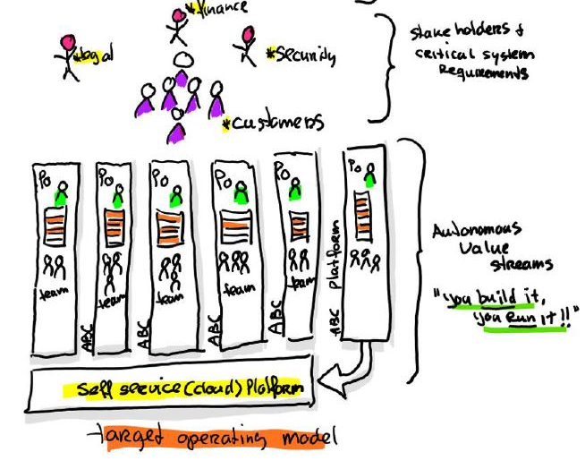
Organization & Team Structure
Team
Team
Team
Team
Team
Notes:
I saved the best for last. The people aspect.

Slide 28
Questions
Questions, comments…

Slide 29
References

